Slide 1

Food Oasis
Justin Heyer
Zi Li Pan
Lucy Sileo
Simran Zaveri

Slide 2
Purpose/Goal
Make nearby food sources readily available for those who need it from open markets and vendors
Makes it possible for individuals to easily sell or give away excess produce to prevent waste
Allows buyers to find available produce nearby that would otherwise potentially go to waste

Slide 3
Technical Platform
API: Android Location API or Google Geolocation for location services
Database: Firebase
Development: AndroidStudio for app development, VS for development
Figma or AdobeXD for mockup

Slide 4
Seller Storyboard
Mary is going out of town tomorrow but has some produce and other foods that would go to waste so she downloads FoodOasis. | She registers an account to become a seller. She inputs her name/business and phone number.
Mary inputs what type of food she wishes to sell (dairy, vegetables, fruits, etc.), a description of the food, price range, and when/where the food will be offered. Enters location via manual input or ”current location”. | Item is now on the market.
1
2
3
4

Slide 5
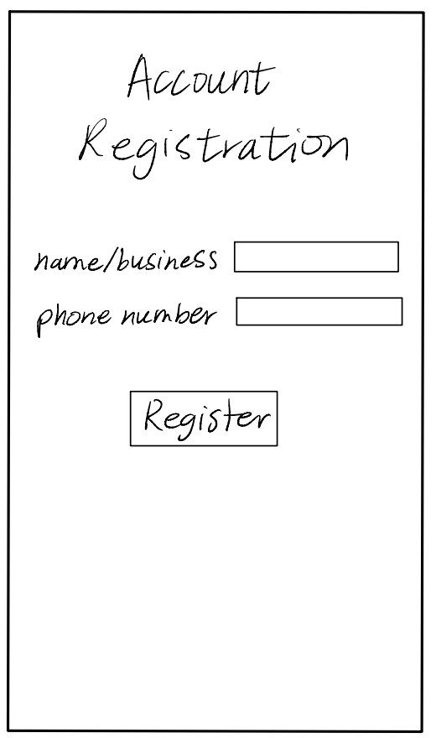
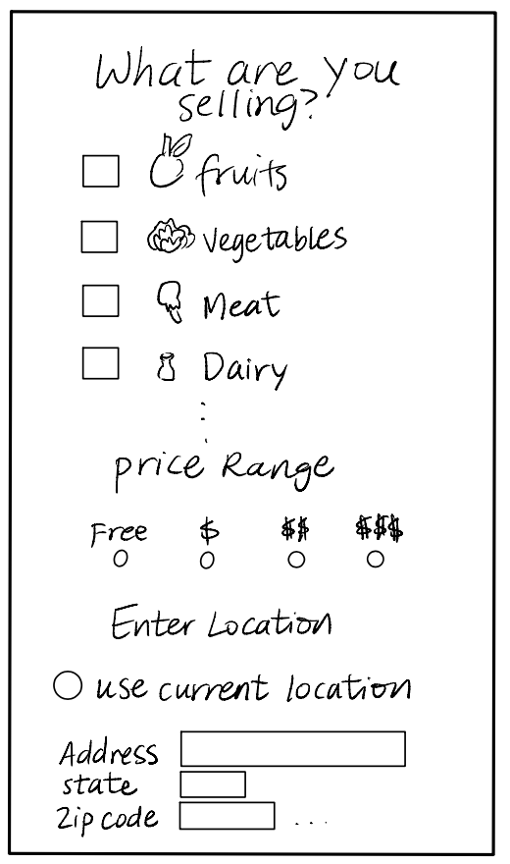
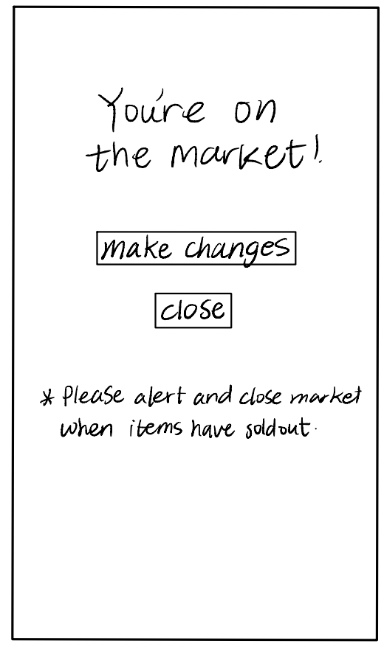

Slide 6
Buyer Storyboard
2
Joe is looking for produce/food nearby. Specifically, some vegetables and dairy products. | He opens the app and joins in as a guest buyer. There was no need for account registration.
He’s asked what kind of produce/food he’s looking for from a list. He selects vegetables and dairy. | A GPS locating the nearby vegetable and dairy sources appears. He’s able to click and view his options based on preference. He chooses a nearby market.
The GPS then routes him to the market.
1
3
4
5

Slide 7
The End
Any questions?

